Slide 1

Houston, TX
2019
#XamDevSummit

Slide 2
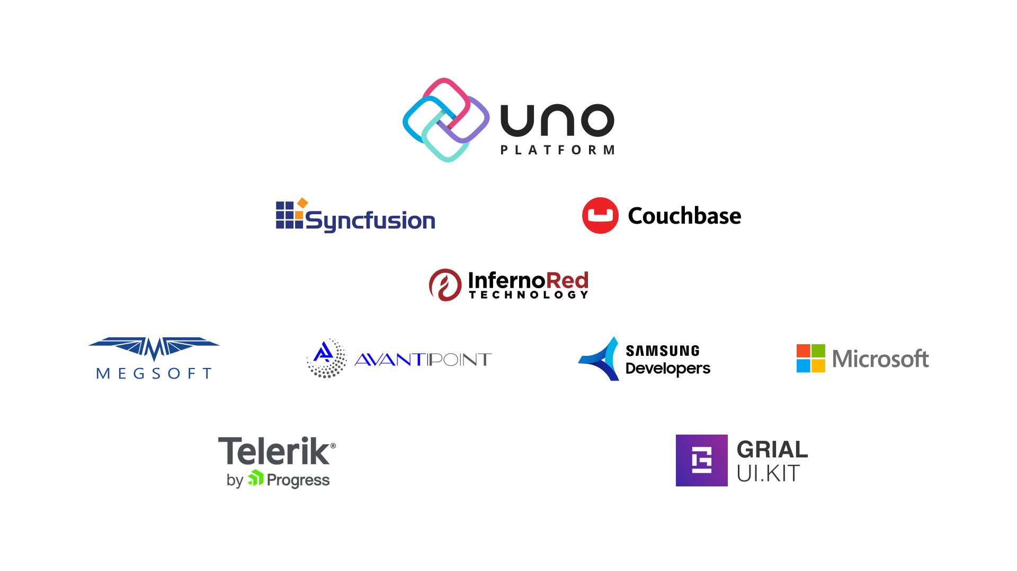
Notes:
Welcome everyone, let’s kick things off with a shout out to these sponsors whose support helped make this event possible.

Slide 3
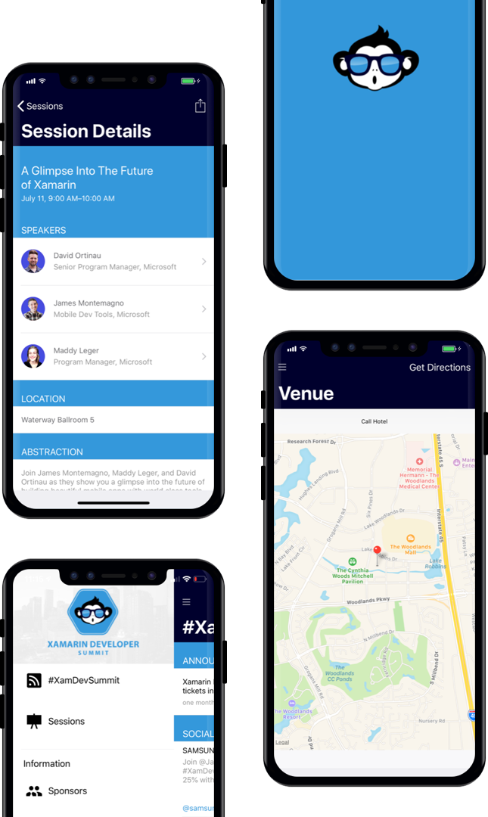
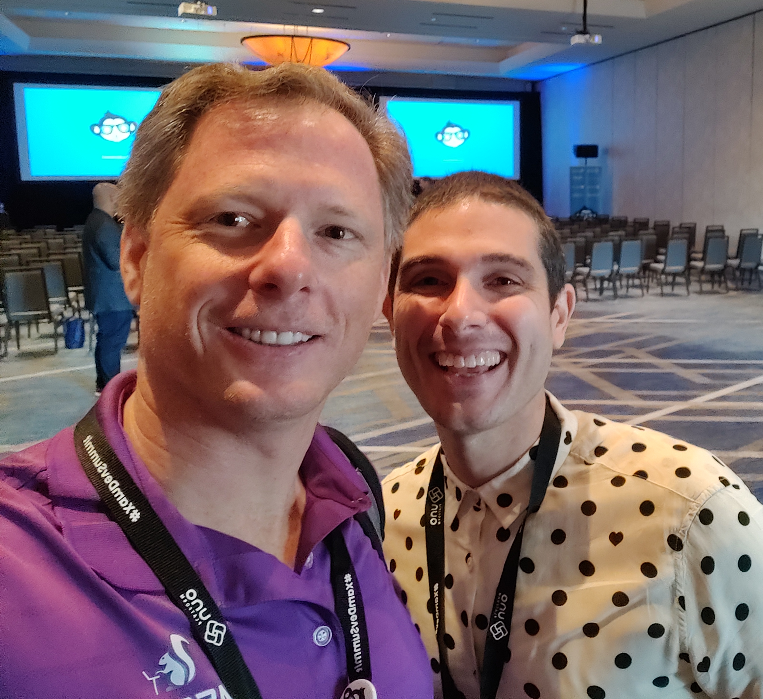
AGENDA
Download our Xamarin based mobile app: XamDevSummit.
Notes:
Just in case you are not aware, there is a mobile app available for this event. If you are familiar with it, that’s awesome because you are then fully-prepared for this talk. The sample application I am sharing with you today is also a Xamarin application designed for conferences. We call it ConferenceMate and it was inspired by a similar app James Montemagno put together for Evolve 2016. We’ll get to that in just a minute…as I should really introduce myself.

Slide 4
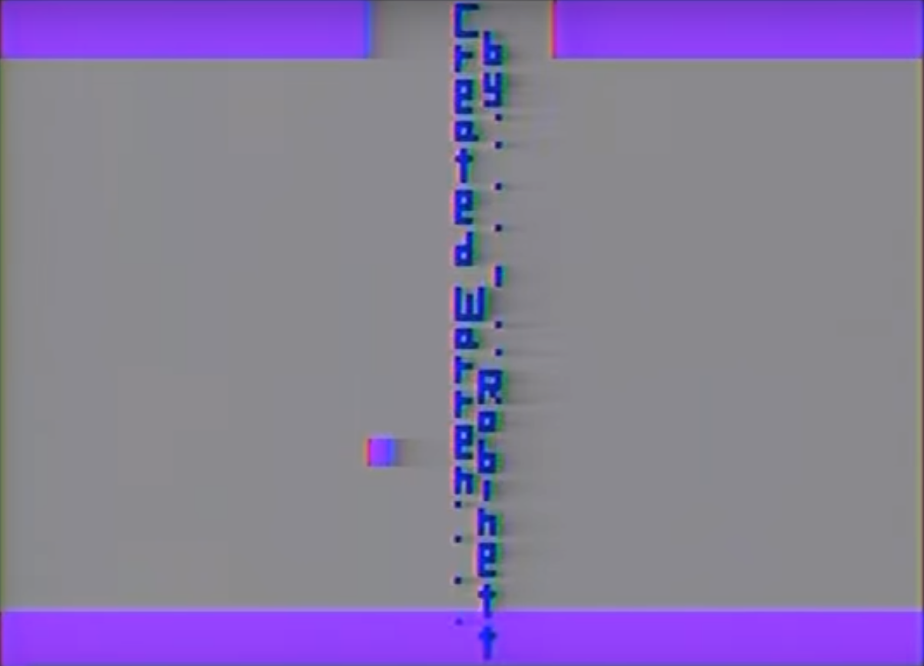


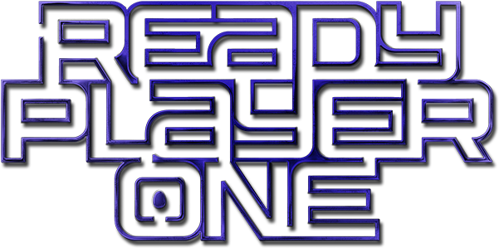
Rapid Enterprise Architecture
Paul Schroeder
@PaulBSchroeder
Notes:
Bachelors Degree, MBA Degree, MCSD
MSC Technology Consulting – Silver Partner
Train / Augment Staff
History behind that blocky font? - Warren Robinett
Atari game titled Adventure, released in 1979 – “Easter Egg”
Our work - factory output rather than artistic expression
Code we write follows boilerplate patterns that can be tedious to repeatedly code
The idea that we should code-generate that stuff is not a new one
Let our creative brains focus on value-add areas like user experience, business rule implementation, and systems integration
My goal is to provide an example of how to build well-structured, maintainable apps using a layered architecture along with clear separation of concerns for enterprise projects.

Slide 5
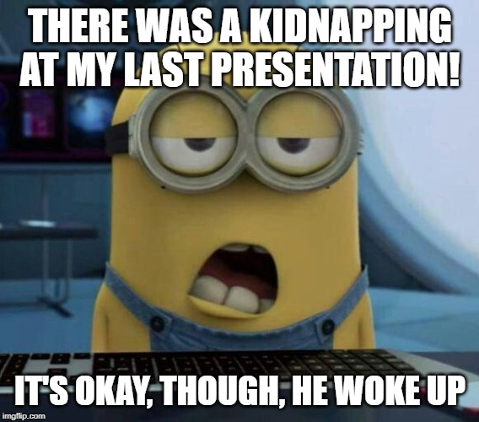
Notes:
Now, around this time of day, I usually find myself feeling the way this minion looks.
However, there will no sleeping in class today – we have a lot to cover!
It would take two hours to properly deep dive into this enterprise architecture and we only have 45 minutes.
Overkill - If you only build one or two small, simple, Xamarin apps per year
We’re talking about long-lived, extensible, applications with big databases containing data that must by synchronized between client and server.

Slide 6

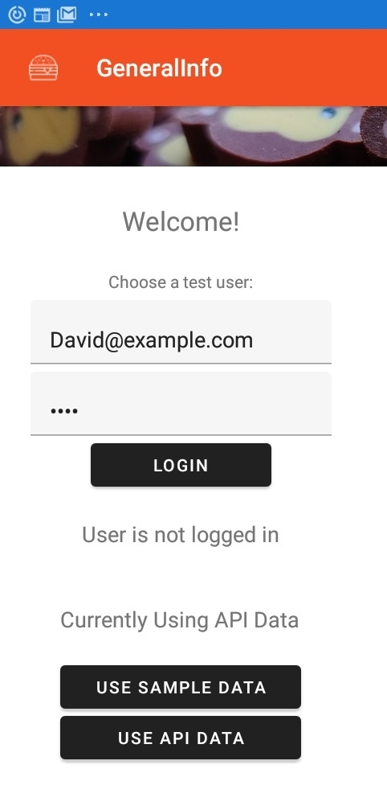
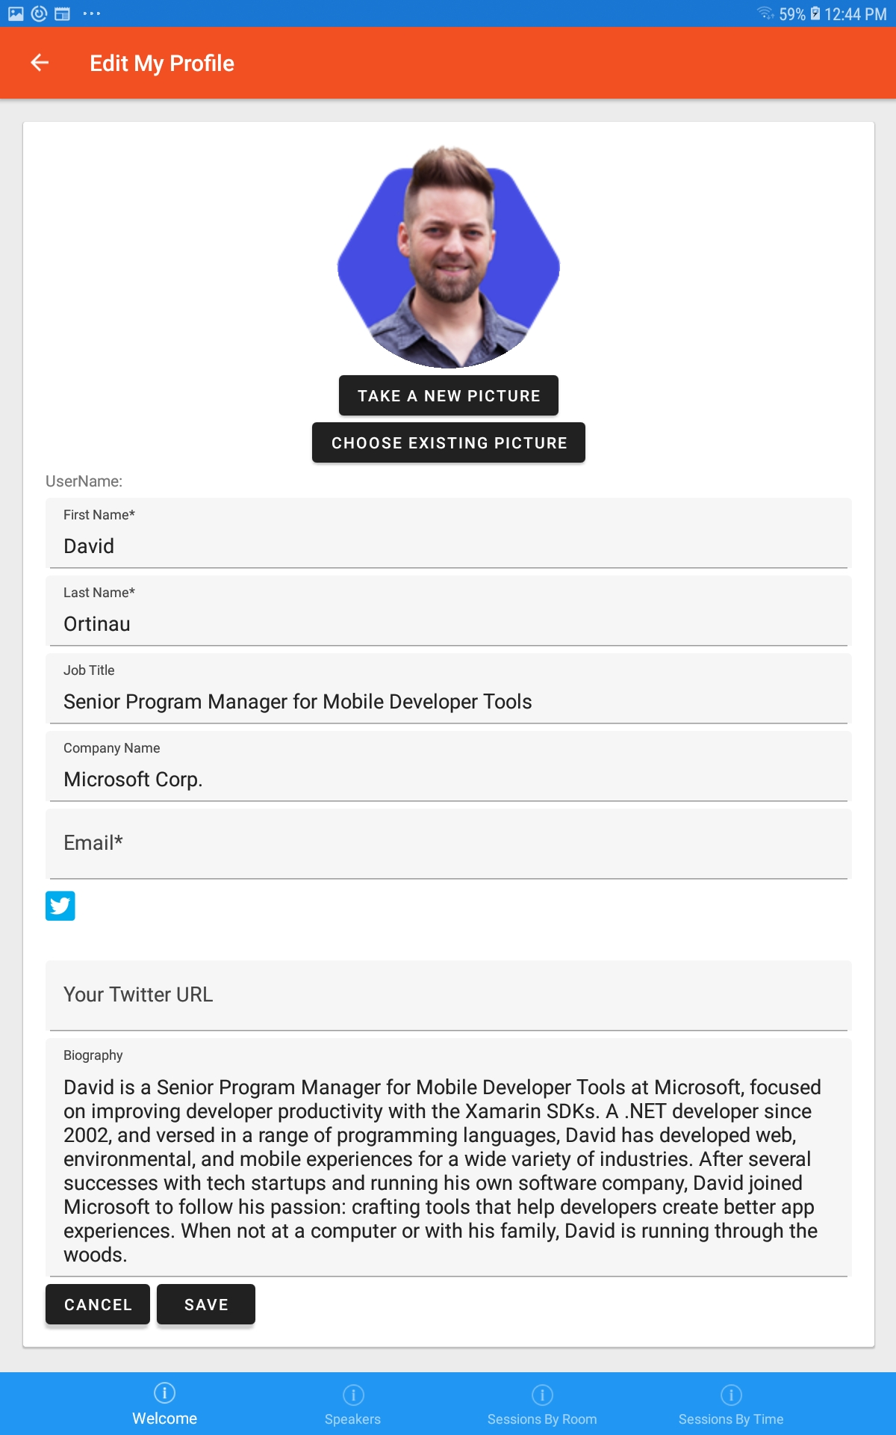
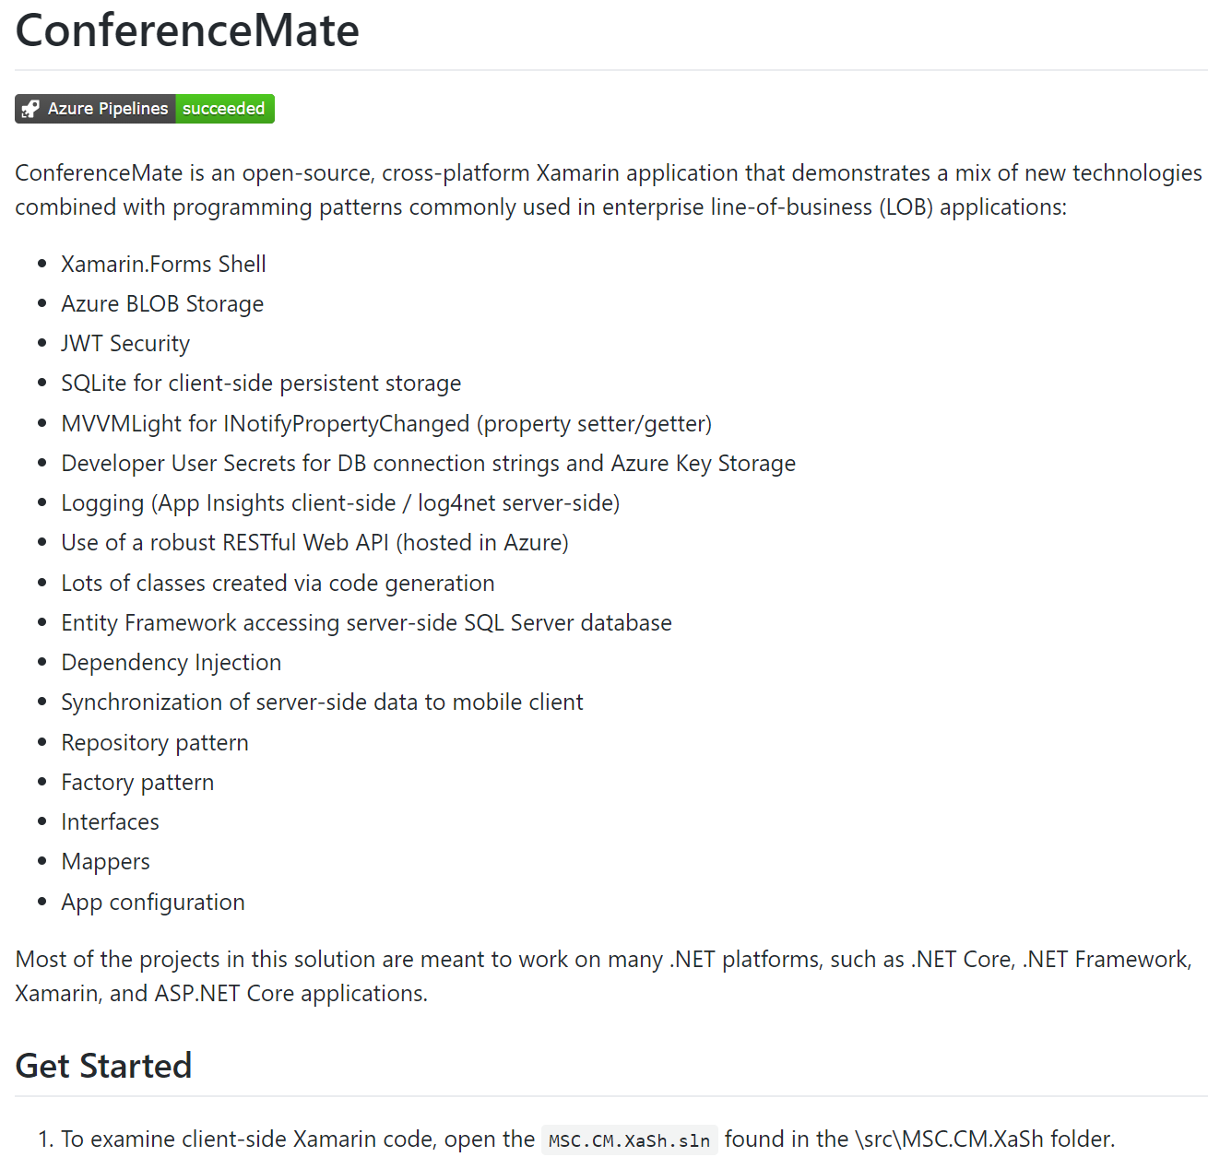
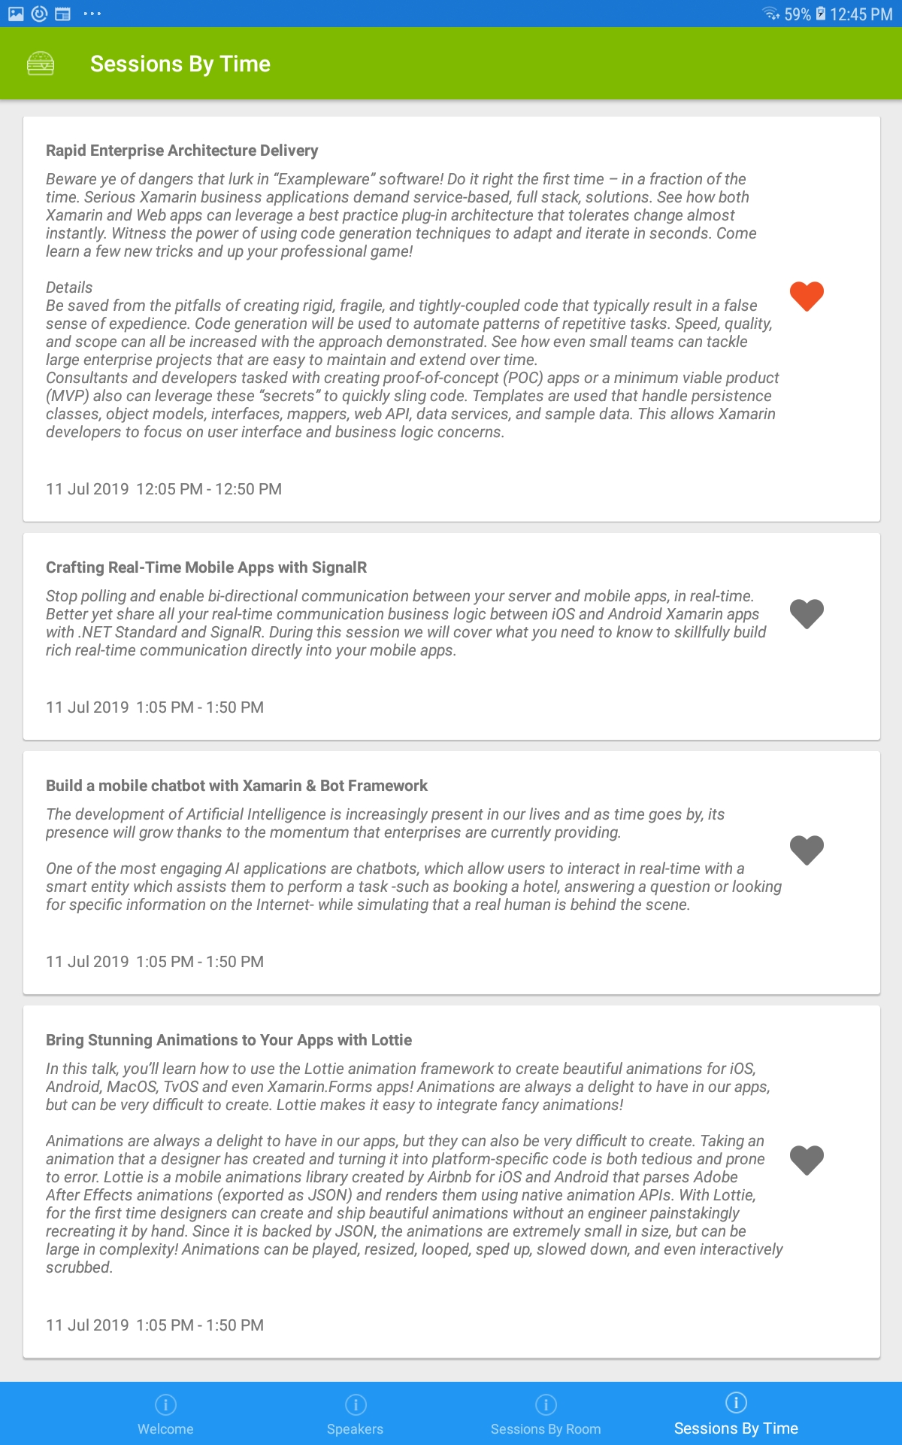
ConferenceMate Open Source App
ConferenceMate Video
Notes:
ConferenceMate is a Xamarin application that implements the new Xamarin Forms 4.0 Shell. We thought this was appropriate for the talk because Xamarin Forms Shell seeks to reduce the complexity of building mobile apps by providing fundamental app architecture features. As you’ll see, this is exactly what we seek to do with code generation and componentization of the architecture’s foundations.
Props – Robin Schroeder
What does app do? Full list of features on GitHub.
We’ll walk through some of these features as we dig into the code. But first, let’s fire this puppy up and see what happens!
Login JWT – Swap sample data for live data
Azure Blob storage for user profile images
Session likes – favorites list – persisted to Azure SQL

Slide 7
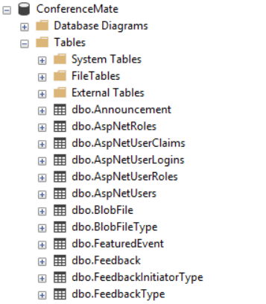
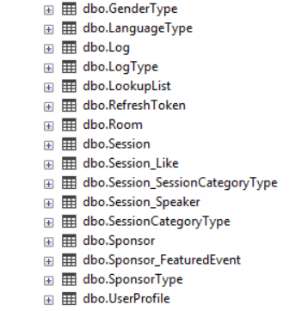

Slide 8
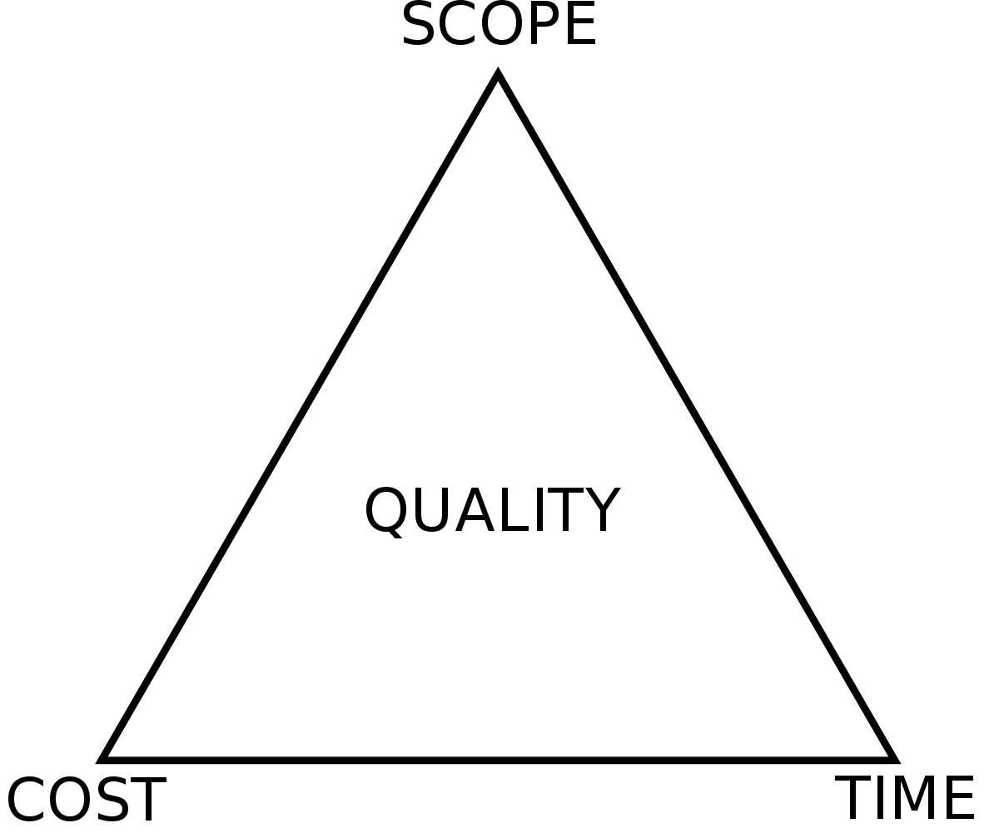
Project Management Triangle (aka Iron Triangle)
You can deliver at the right cost (budget) and on time (schedule), but may have to sacrifice scope.
You can have all the scope you want by the deadline you set, but the cost may be higher. (i.e. staff augmentation / OT)
Trade between constraints
Good, Fast, Cheap:
“Pick any two, you can’t have all three”
Should be fixed, but often suffers.
Notes:
Project Management Triangle / Iron Triangle - since the 1950’s as a simple way to model the constraints of project management.
Cannot change one corner of the triangle without affecting the other constraints.
For time eternal there will always be reasons management tries to defy the triangle
Developers can advise, but we’re usually not the decision-makers.

Slide 9

Problems
Not Aligned:
Budget, Scope, Time, Quality
Demo now, build it out later
Software Requirements:
Changes, Misses, Ambiguity
Development Team Turnover
App Differs from Market Needs
Systems Integration Challenges
Notes:
Touched on the first point; one thing I might add is developers are notoriously optimistic about how long it will take to be done-done. We may focus on just the coding aspect and ignore the numerous small, but necessary tasks that must occur along the way. We have a lot of Xamarin developers here – I’m not even going to ask for hands on whether anybody has unexpectedly lost productivity due to environment issues or SDK updates.
Hold off on the demo now point until the next slide
Software requirements - ambiguity, a software developer will do one of two things: guess, possibly causing rework later, or ask for clarification. The impact of rework is obvious and the time to get a clarifying decision is not always timely. By the way, back to the first point, did you account for that rework due to a wrong guess or assumption in your time estimates?
It is very common these days for developers to change companies every couple of years. When projects begin to stretch longer than six months the risk of team members moving on before completion rises substantially. When that departing person goes, those remaining must often interview, hire, and train a replacement. Now that team is losing productivity from multiple directions.

Slide 10
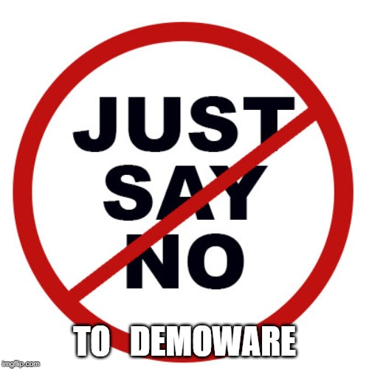

Beware of Demoware!
“There’s never enough time to do it right, but there’s always enough time to do it over.” – Jack Bergman
Notes:
I’ve been on projects, and, perhaps, you have too where the initial phases are dominated by the business needing customer or stakeholder presentations. It doesn’t have to work, it just needs to look like it works.
“Demo features X and Y to this potential customer.”
“Show stakeholder Z because they control our funding.”
“The conference is in 3 weeks and….”
The problem, of course, is that once stakeholders see something that looks like it works they think it is nearly complete. Developers know this is untrue and that establishes incongruence in go‑forward expectations.
Most of the time on this type of project, if you think you’re going to get the time to go back and do it right, you’ll be wrong.
I like Jack Bergman’s quote - I’ve seen it happen multiple times.

Slide 11

Root Cause of Problems
Insufficient Planning and Requirements
Focus on Demonstrations
Shifting Project Requirements
Losing Key Players
Feedback Loop is Lacking
Systems Integration Challenges
Notes:
I want to make sure we understand the difference between focusing on demonstrations and a feedback loop.
The former is when adequate time is not given to develop code prior to it being showcased and, sometimes, sold.
The latter is when team members are not making progress videos or holding sprint review meetings to communicate where things are at and receive course-correcting directions

Slide 12

The Repeatable Solution
Time Reduced
Integration / Technology Risk Earlier
Adapt to Market Needs
Turnover Mitigated
Quality Increases
Code Generate Boilerplate Sections
Use Proven Software Patterns (SOLID)
Componentize Architecture (NuGet)
Craft a Reusable Architecture
4
3
2
1
Notes:
This is the roadmap for our talk.
What I’m saying here is that if you travel a path from item 1 to item 4 that you will reach a wonderful destination.
That destination is the point where your team can deliver high-quality enterprise applications astonishingly fast.
We’re talking about a fraction of the time with a fraction of the resources.
Not only that, but quality actually goes up.
There are a number of side-benefits to delivering faster as well – turnover issues are reduced and it becomes easier to adapt to what is learned from the first release.
A hidden benefit is that when turnover does happen, the replacement developers have clear patterns to follow. If they have worked on another project that used the same approach, their ramp-up time to understand the code base is almost nothing.

Slide 13


High-level Architecture
After Code Generation –What’s Left?
SQL Server
Database
Web API
Data Load Service
SQLite
Database
Model
EF
DTO
DTO
Data
Mapper
Get All Pages
Mapper
lastUpdatedDate
Business Logic & Domain Classes
SERVER
Xamarin CLIENT
MVVM
View
MVVM
View Model
Model
Model
Obj
Data
Mapper
Notes:
There are quite a few parts to this architecture, but each serves its own purpose in the name of implementing the SOLID principles espoused by Uncle Bob Martin. I’ll point out a few of these as we walk through the code in a minute. When making changes, we actually save data back to a queue in the SQLite database.
Can anyone tell me why we do this?
Resilience against intermittent connections
Enables off-line scenarios
Performance – much faster to save locally than wait on the latency of a Web API call to successfully complete. Our users demand responsive applications.
Okay, here’s a really cool part - let me show you just how much of this can be code generated. Are you ready? Watch closely now….
After Code-Generation – What’s Left?
Well, The MVVM ViewModels and Views must be written. Also, the business logic must be written. But these are the things we want our developers to focus on; not slogging through creation of boring, tedious, repetitive class files. As a side benefit, our code is perfect – it’s free of human flaws

Slide 14
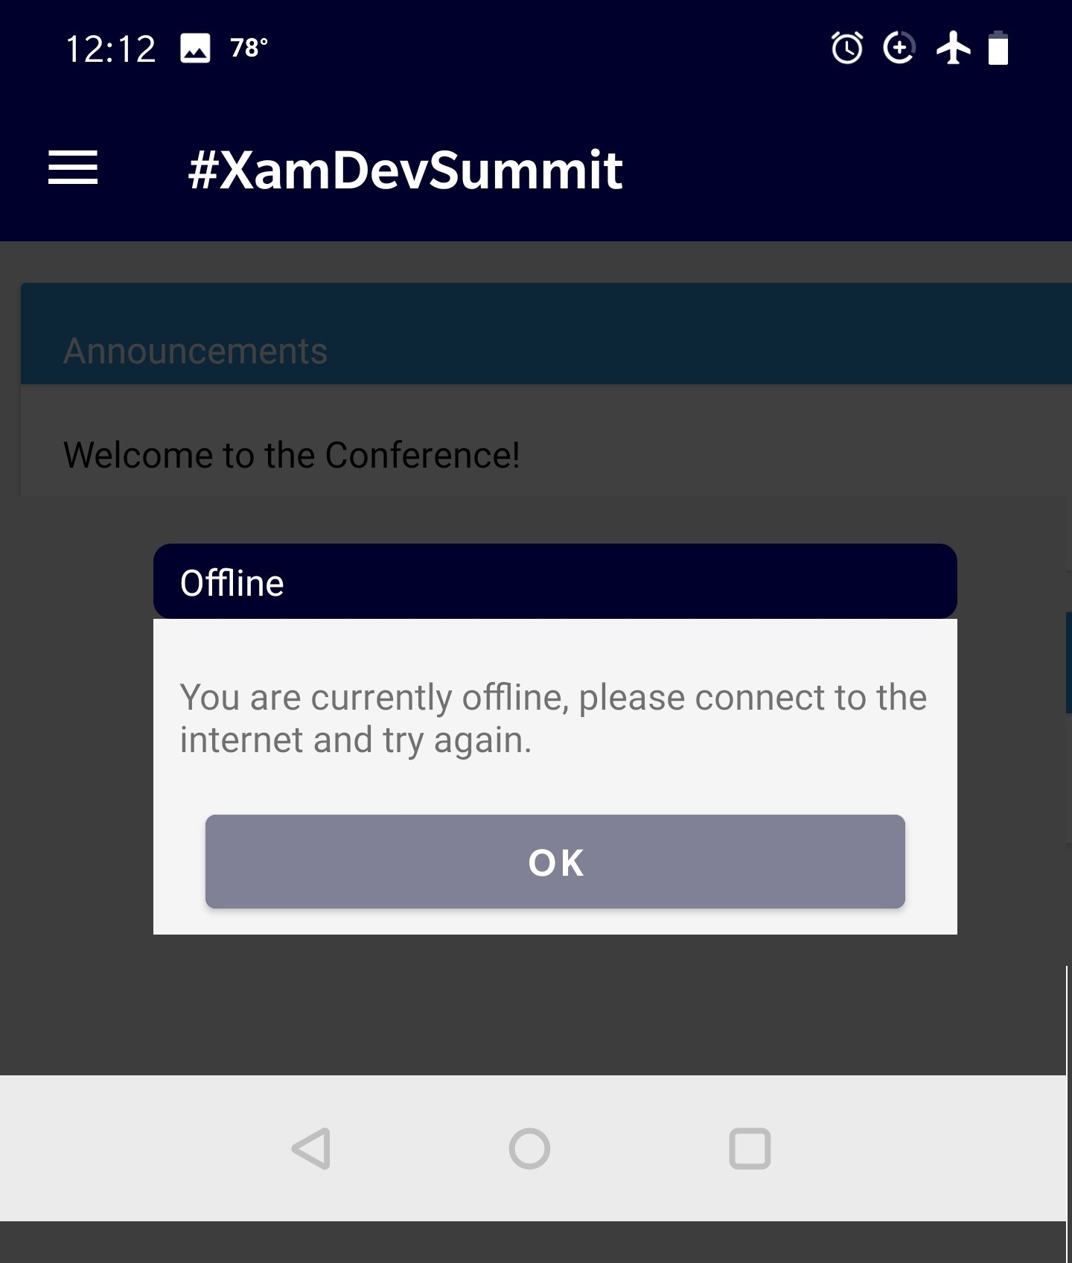

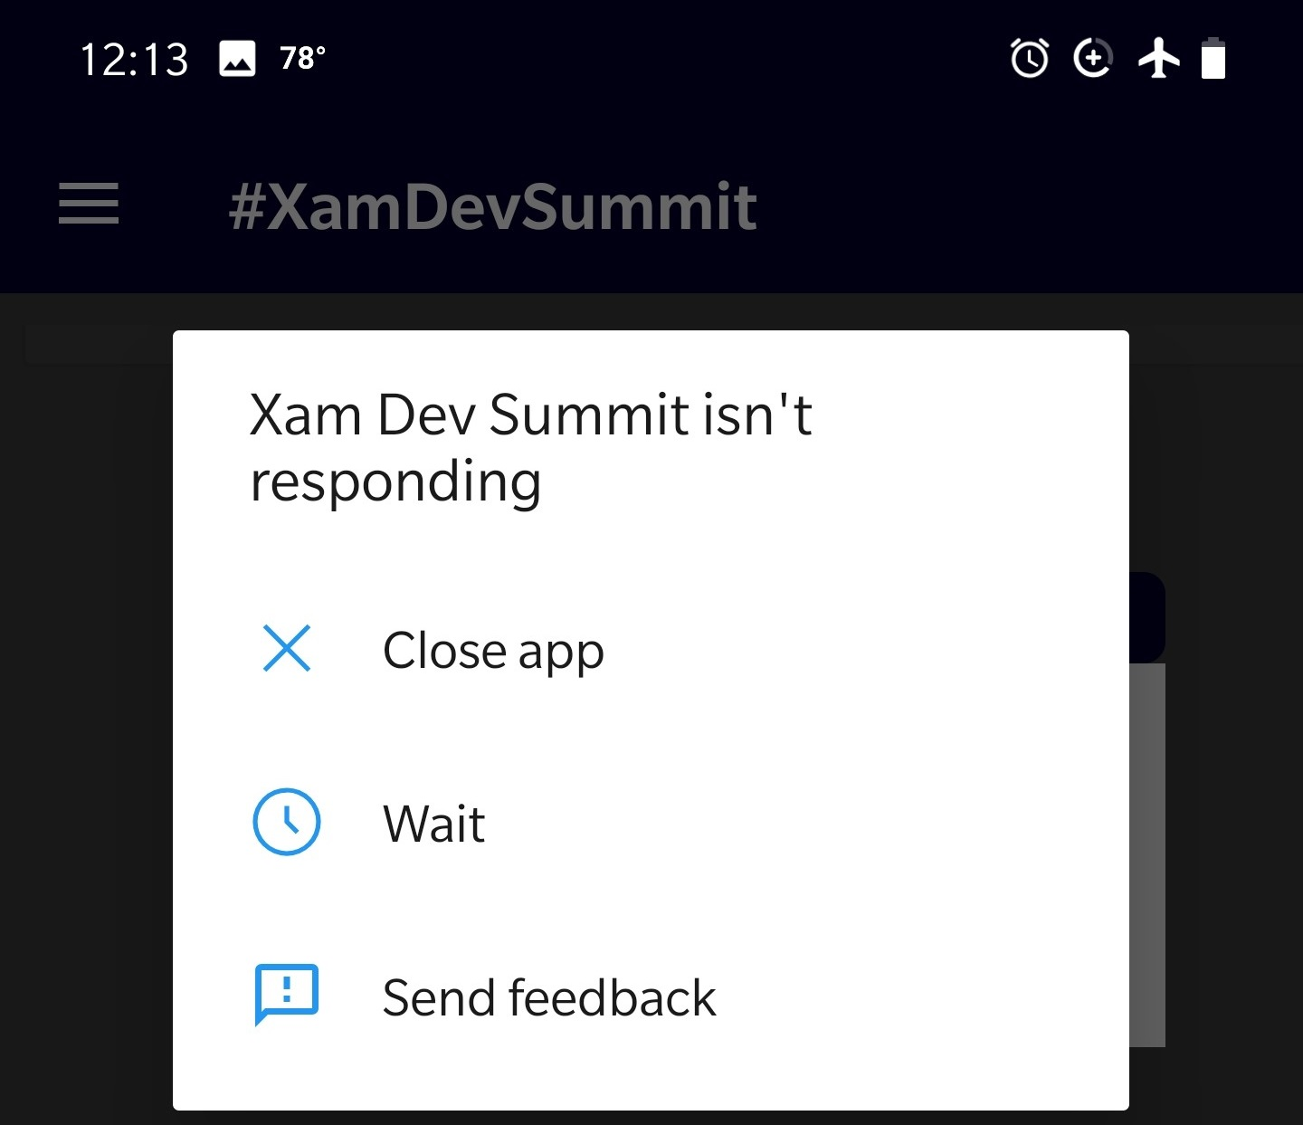
There is a Reason!
Offline Capability
Baked In
Notes:
I’ve been on projects, and, perhaps, you have too where the initial phases are dominated by the business needing customer or stakeholder presentations. It doesn’t have to work, it just needs to look like it works.
“Demo features X and Y to this potential customer.”
“Show stakeholder Z because they control our funding.”
“The conference is in 3 weeks and….”
The problem, of course, is that once stakeholders see something that looks like it works they think it is nearly complete. Developers know this is untrue and that establishes incongruence in go‑forward expectations.
Most of the time on this type of project, if you think you’re going to get the time to go back and do it right, you’ll be wrong.
I like Jack Bergman’s quote - I’ve seen it happen multiple times.

Slide 15
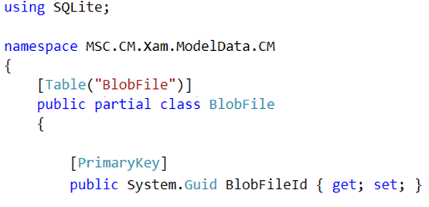
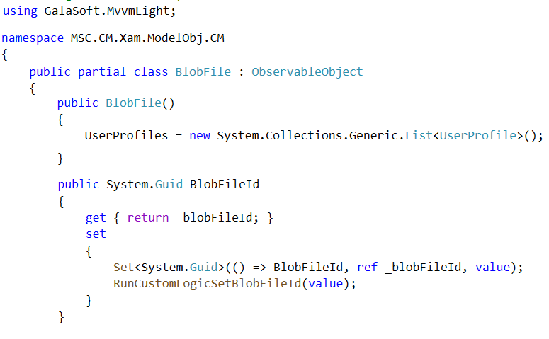
Single Responsibility Principle
SQLite classes - ModelData
MVVMLight classes - ModelObj
Let’s Look at Some Code!
Notes:
“S” in SOLID
SQLite vs. MVVMLight classes have different needs that include being observable objects and implementing INotifyPropertyChanged

Slide 16

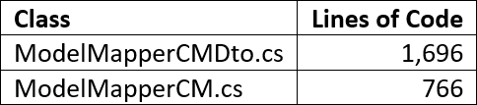
Models, Mappers, and DTO’s – Oh My!
22 classes for each:
SQLite
MVVMLight
DTO
Sample Data
88 classes you do not have to write !!!
// <auto-generated> - Template:SqliteModelData, Version:1.1, Id:c5caad15-b3be-…
Notes:
Limited number of database tables; 22 tables. However, when you multiply even this modest application’s needs, that translates into 88 classes spread across 4 templates plus thousands of lines of code to map between the different objects.
Technically, you could use AutoMapper for those last couple, which we do on the server-side. However, with a code generator it isn’t really necessary.

Slide 17
Code Generation Basics
Create Templates
With expected input parameters (i.e. Table name, Column name)
Extract Inputs / Metadata from Source
i.e. DB Schema or Open API specification
“There is more than one way to skin a cat.”
“There are always several ways to do something.”
Run Templates with Metadata as Input
Output class files and incorporate them into your solution
Notes:
Two things before we continue:
You do not need to use code generation to benefit from the patterns demonstrated in this sample solution. It’s just way faster to do so.
The way we do this at MSCTek is certainly not the only way.
T4 templates, which MVC uses, tools like LLBLGen, CodeSmith, and Iron Speed Designer
We chose to roll our own, create a Visual Studio extension out of it, and call it CodeGenHero
Regardless of the path you choose, the basic steps are the same for each method:
Craft templates that function based upon known inputs
Extract metadata from a source (i.e. DB Schema or Open API specifications) that provide those inputs
Apply the metadata to the templates and extract the output

Slide 18
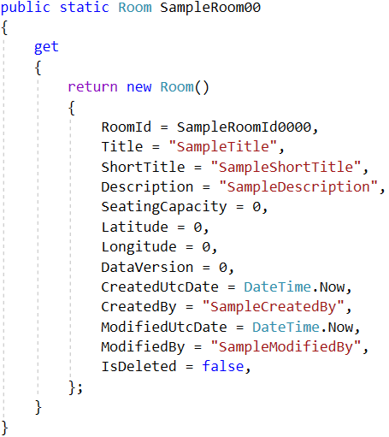
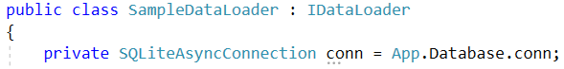
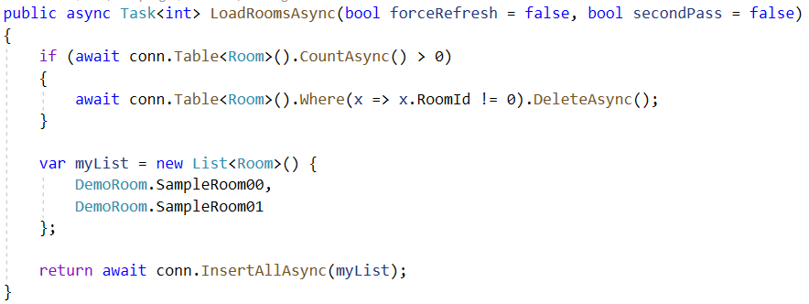
Sample Data
Data Loader
Robin Schroeder
3 pm tomorrow
// <auto-generated> - Template:XamSample, Version:1.1, Id:9131a0a2-…
Notes:
A drawback with generating sample data is that its values are often pretty generic. For example, a room’s title comes out as “SampleTitle” instead of “Waterway 8”.
Now, a really cool feature of the app is how to use the combination of interfaces and dependency injection to swap out sample data for live data. In fact, this application is designed to do that live; on the fly. Interfaces and Dependency Injection are the “I” and the “D” in our SOLID principles, respectively. By following the SOLID principles, we’re able to make a pluggable architecture that can easily adapt to change – such as swapping out your data provider altogether.
This is something we have been doing for a while with great success. Also, the new Xamarin Forms Shell comes with this approach baked in out-of-the-box.

Slide 19
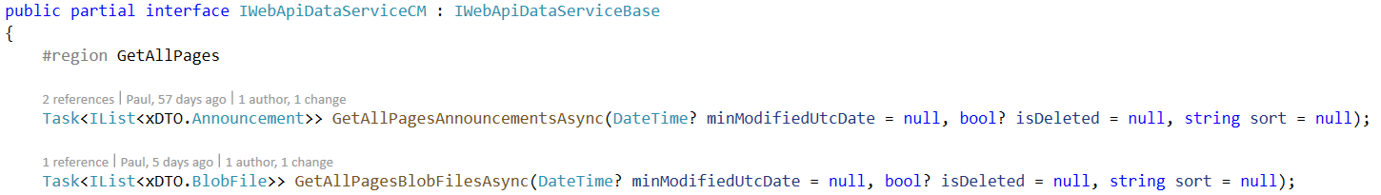
Client Code to Access Web API (Interface)
Abstract away the complexity of invoking the Web API
Provide CRUD operations
Get All Data
Get Pages of Data
Get By Primary Key
Create, Update, Delete
Notes:
The purpose of this code is to make it so the Xamarin developer has very little to worry about when integrating with the server. Yet, we still receive all the benefits that come with a Service-Oriented Architecture.
We are going to look at the CRUD operations on the left in code in just a moment.
First, I want to have a conversation about why we have all the parameters listed on the right.
Can anyone tell me the value of soft-deleting records? Why would we do this instead of simply hard-deleting the record?
Can anyone tell me why we are using modified date parameters in our get calls? Well, it has to do with synchronization and limited bandwidth. We don’t always want to load an entire set of data…we only want what has been changed since the last time we requested that data.
Can you guess what the numChildLevels parameter does in the Web API? It’s there to return an object graph of data, or entities that are related to the object we are querying. Imagine people can submit feedback about each session. We may want to display that feedback in a list view on the same screen that we see session information. By setting this parameter’s value to 1, we can get that data in a single call to the Web API instead of making separate calls.
The last parameters I want you to look for in the code are sort, page, and pageSize. These are used when we want to display or load one page of data at a time; not the entire table. This proves particularly useful in Web‑based applications that want to provide a pager control that only loads and displays one screen of information at a time.

Slide 20
Client Code to Access Web API (Interface)
DateTime? minModifiedUtcDate
bool? isDeleted = null
int numChildLevels
string sort
int page = 1
int pageSize = 100
IList<IFilterCriterion> FilterCriteria
Useful for data synchronization
DateTime? minModifiedUtcDate
bool? isDeleted = null
Related entities
int numChildLevels
IPageDataRequest
string sort
int page = 1
int pageSize = 100
IList<IFilterCriterion> FilterCriteria
Notes:
The purpose of this code is to make it so the Xamarin developer has very little to worry about when integrating with the server. Yet, we still receive all the benefits that come with a Service-Oriented Architecture.
We are going to look at the CRUD operations on the left in code in just a moment.
First, I want to have a conversation about why we have all the parameters listed on the right.
Can anyone tell me the value of soft-deleting records? Why would we do this instead of simply hard-deleting the record?
Can anyone tell me why we are using modified date parameters in our get calls? Well, it has to do with synchronization and limited bandwidth. We don’t always want to load an entire set of data…we only want what has been changed since the last time we requested that data.
Can you guess what the numChildLevels parameter does in the Web API? It’s there to return an object graph of data, or entities that are related to the object we are querying. Imagine people can submit feedback about each session. We may want to display that feedback in a list view on the same screen that we see session information. By setting this parameter’s value to 1, we can get that data in a single call to the Web API instead of making separate calls.
The last parameters I want you to look for in the code are sort, page, and pageSize. These are used when we want to display or load one page of data at a time; not the entire table. This proves particularly useful in Web‑based applications that want to provide a pager control that only loads and displays one screen of information at a time.

Slide 21
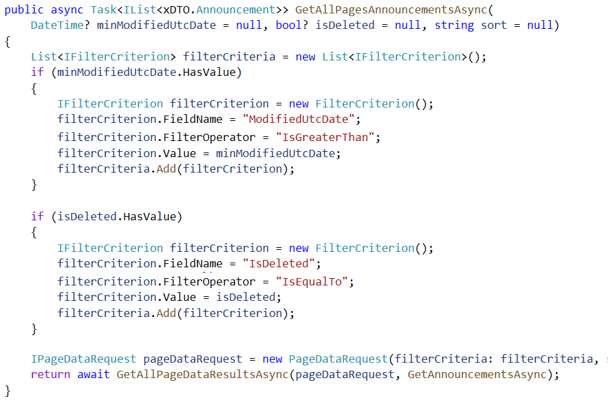
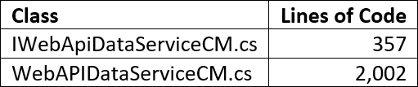
Client Code to Access Web API (Implementation)
What field(s) to use in filter?
How do you want to filter it?
Operator, Value, Sort
Your own custom methods
Partial Classes
ODATA(ish)
// <auto-generated> - Template:WebApiDataService, Version:1.1, Id:424e7ec7-...
Notes:
Code is very easy to read, even though enumerations should be used in a couple of places.
If follows a clear pattern, meaning it can be code-generated.
Custom methods can be hand-crafted extending what is available to the Xamarin developer without having to touch the Web API.

Slide 22
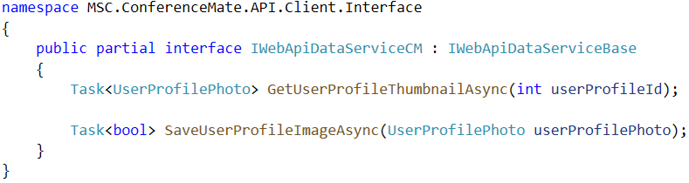
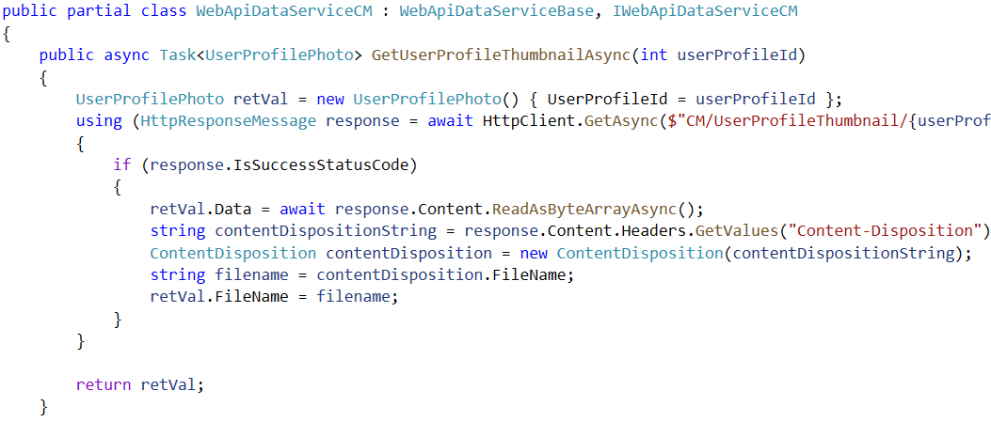
Save / GetUserProfileThumbnailAsync ( )
(Custom Partial Class)
“O” in SOLID
Open / Closed Principle
Custom code to
save / retrieve a user profile image
Flexibility - Implement a custom method using specific IFilterCriterion criteria
Notes:
Let’s take a moment to consider an example of some completely custom code that retrieves and saves user profile images. Just to make this example extra interesting, we include code that implements reading and writing these images to Azure Blob Storage containers. The use of partial classes enables us to extend the interface and implementation classes. This exemplifies the “O” in SOLID for Open/Closed principle; even when we’re using automated code-generation for the same interface.

Slide 23
The Repeatable Solution
You Are Here!
Code Generate Boilerplate Sections
Use Proven Software Patterns (SOLID)
Componentize Architecture (NuGet)
Craft a Reusable Architecture
Touching on SOLID Along the Way
Generic Anemic Model for Data
Several Layers Code-Generated
4
3
Up Next
NuGet Components
Azure Blob Storage (Profile Photo)
Dependency Injection
Keeping Credentials Private
JWT Security / Postman Tests
Web API
Proof – CodeGenHero Magic
2
1
Notes:
What do I mean by item #3, “Componentize the Architecture”?

Slide 24
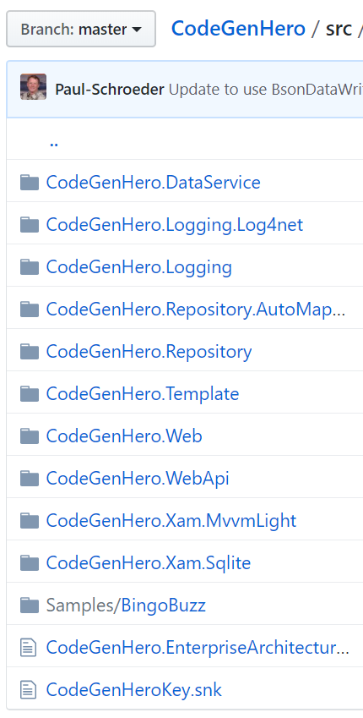
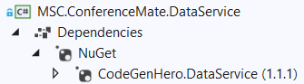
Open Source Components
Foundation classes referenced by the generated code
Base classes used to provide common functionality
GitHub Url
github.com/MSCTek/CodeGenHero/
NuGet Packages
www.nuget.org/packages?q=codegenhero
Notes:
What I mean by “Componentize the Architecture” is that you can take common pieces that are foundations upon which the application is built and package them for reuse. We do this all the time when we leverage NuGet packages that implement various functionality we need in our solutions. Why not do it for your own team? It is quite easy to do and many companies even host their own NuGet servers internally.
What I’ve done with the foundational classes for this architecture is to make them available as open‑source on GitHub. I package that open-source code into NuGet packages which are then published to NuGet.org; search for “CodeGenHero.”

Slide 25
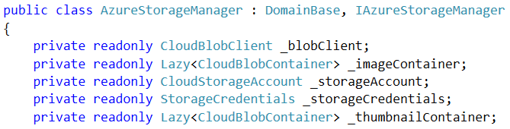
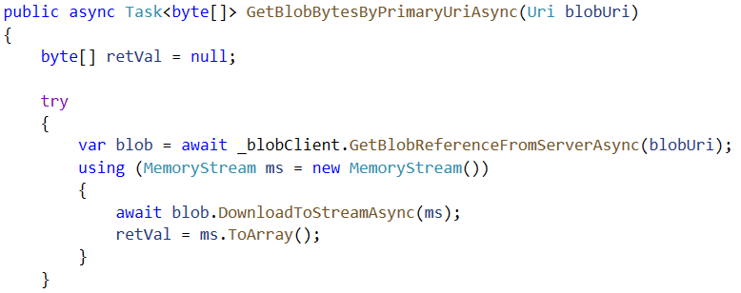
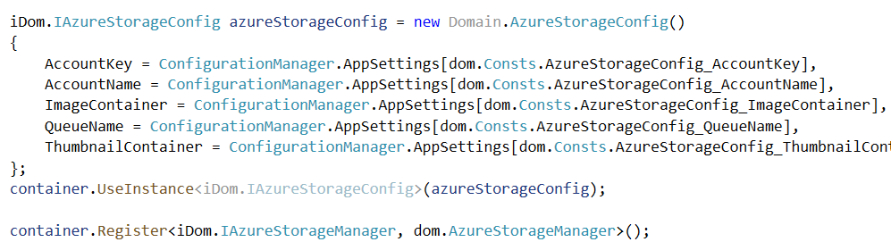
Azure BLOB Storage
Domain Classes – Go
Beyond Anemic Models
Class AzureStorageManager : DomainBase, IAzureStorageManager
IoCDependencyResolver.cs
DryIoc Dependency Injection
Notes:
Let’s look at how that Azure BLOB Storage for the user’s profile photo works. At the same time, this gives us a chance to see where the implementation of a Dependency Injection container named DryIoc gets configured.

Slide 26
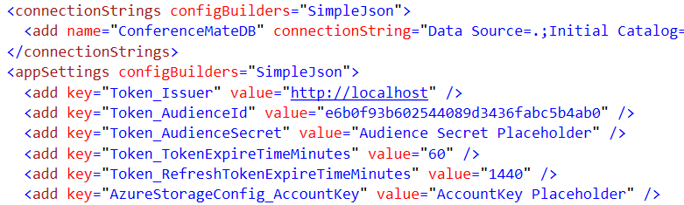
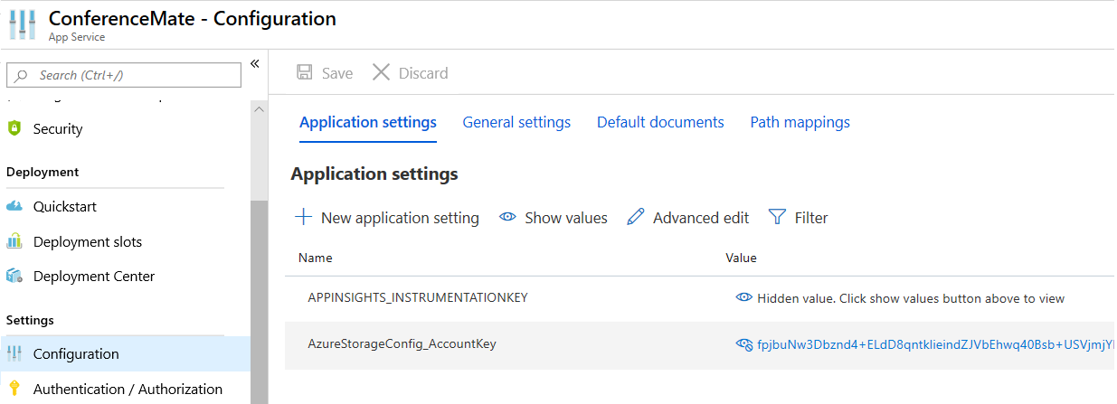
Configuration Secrets
Microsoft.Configuration.ConfigurationBuilders
Do not store sensitive app settings and connection strings in source control!
Azure Portal App Service Configuration
developer_config.json
{
"appSettings": {
"AzureStorageConfig_AccountKey": "fpjbuNw3Dbznd4…",
"Token_AudienceSecret": "kW9ys7u…
},
"connectionStrings": {
"ConferenceMateDB": "Server=tcp:msc…"
}
}
Notes:
Have you ever worked on a development team where you needed your own copy of the database to experiment? I do this all the time. The problem is that I, or my teammates forget to change their custom connection strings and app settings back before they commit changes to the repository. Next thing you know, developers are pulling those changes and losing productivity because suddenly something stopped working.
Alternatively, you might work on a team where it’s not okay for every developer to know the passwords and secrets to each database and service in every environment – DEV, QA, UAT, PROD.

Slide 27
JWT Security
Based on Blog Post by AJ Kerezstes
github.com/akeresztesgh/TokenAuthInAspNet
ConferenceMate uses Microsoft.AspNet.Identity
ApplicationOAuthProvider.cs
JWTFormat.cs
RefreshTokenProvider.cs
Postman Tests
ISession injected ⇒ UserProfileImagesController
CurrentUser.Claims.First(x => x.Type == Consts.CLAIM_USERPROFILEID).Value
CurrentUser.IsInRole( Consts.ROLE_CONFERENCEORGANIZER)
if (_session.CurrentUserProfileId == userProfileId
|| _session.CurrentUserIsConferenceOrganizer)
Authorize attribute
Change User Profile Image
Postman Test 1.mp4
Collection Runner.mp4
Notes:
Due to our time limitations, I am not going to be able to deep-dive into how the token-based security is implemented in ConferenceMate. I would suggest that you read the Blog post by AJ Kerezstes that is linked to by his GitHub repo shown on this slide. Also, the bullet points here identify the key class files in ConferenceMate that you’ll want to examine.
Another thing that I like about this architecture is that I’m able to inject an ISession object into my controllers.
Convenience checks for security permissions.
There is a business rule that states only the user him/herself can update their profile photo or a conference organizer can do so. You’ll see the difference between a claim check and a role-based check in the server-side code that processes an uploaded user profile image.
So, let’s make Postman tests our final item for today’s talk. We are going to use Postman to test our wonderful Web API. Before we do so, I just want to point out one more feature of the Web API that you’ll need for enterprise development; versioning the API.
Notice how all our Web API methods are decorated with a “Dataversion” attribute containing a value of “1”. When it comes time to alter the behavior of that Web API, you can make a new method with the same route name, give it a different version, say 2, and allow legacy client applications to still function while you roll out the new version market-by-market.
Now, we’re really short on time so let me just show you what can be done with Postman’s collection runner. You’ve heard of automated unit tests? Well, this is automated Web API tests. Basically, we set up some requests, configure a couple of common variables by environment, and write JavaScript tests against the results. Let’s examine a few and then run this thing and open it up for Q&A.

Slide 28
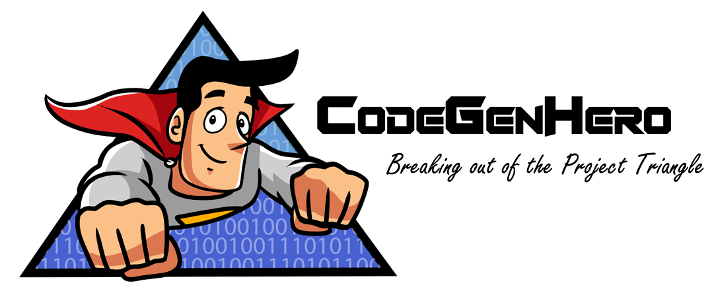


Thank You!
https://github.com/xamarindevelopersummit/XamDevSummit2019/
Q & A
Stickers & Personal Demos Available
Paul Schroeder
@PaulBSchroeder
Paul@MSCTek.com
CodeGenHero Bingo Buzz Video
Notes:
Conclusion
There you have it folks, we have walked through several major pieces of an enterprise architecture in under 45 minutes. I do apologize if it moved fast and wasn’t deep enough for some of you. However, remember you have the sample code and slides to refer to later. Also, here is my contact information if you have questions. If you liked something in this talk, please follow me on Twitter at PaulBSchroeder. If you really liked something in the talk and want us to help you with a project, we would love to hear from you. Finally, stickers and personal demos of CodeGenHero are available. Either catch me here or email to setup a virtual meeting.
If you have a big database and don’t want to hand-code hundreds of classes, let’s chat. That’s it, I hope you are left with some new ideas and great code examples that you can use to jumpstart your next project!

